Slide 1
Migrant homelessness and destitution
Maria Iglesias and Ghelila Masho

Slide 2
CONTEXT

Slide 3
Global context
Conflicts creating refugee movements
Human trafficking
Forced labour
Globalisation
Development
Most refugees are hosted in global south, only 6% in Europe

Slide 4
UK context
Demonisation – hostile environment
Blocking access to services – housing, health
Rising homelessness and destitution
Focus on reconnections as the only solution & services working with enforcement – people not given options
Immigration Act – internal controls/criminalisation

Slide 5
THE ISSUES

Slide 6
Homelessness
Destitution
Immigration status
Trafficking
Domestic violence
Status of family

Slide 7
PUBLIC FUNDS

Slide 8
What are public funds?
A range of benefits, generally related to lower incomes and housing support, including:
Job Seekers Allowance (JSA)
Housing benefit
Local authority homelessness assistance
Disability Living Allowance

Slide 9
What are public funds?
….but not including benefits based on National Insurance contributions:
Contribution based JSA
Retirement pension
Statutory maternity pay

Slide 10
Health care
NHS services are not considered public funds, but:
Everyone is entitled to free primary care
GPs cannot refuse to register someone because they lack proof of address
Those not ‘ordinarily resident’ may have to pay for hospital care
Notes:
People are entitled to free primary care, regardless of their immigration status
GPs cannot refused based on proof of address, but they frequently do
‘Ordinarily resident’ means UK citizen, Indefinite Leave to Remain, or EU citizen exercising treaty rights

Slide 11
Health care
People exempt from all health care charges include:
Refugees and those seeking asylum
Victims of trafficking or modern slavery
Children in care
People in immigration detention
People receiving treatment under Mental Health Act
Notes:
These are key examples, not an exhaustive list

Slide 12
NRPF
No Recourse to Public Funds (NRPF) is not an immigration status
It may be a condition of somebody’s permission to be in the UK (e.g. spouse or student visas)
It may be a default position because somebody does not currently have permission to be in the UK
Notes:
The Home Office is giving increasing numbers of people NRPF as a condition of their leave to remain

Slide 13
Sandra’s story
Sandra is sole carer of her British child
Victim of unscrupulous solicitor
Visa expired, making her an overstayer
Eventually applied for limited leave to remain – granted with NRPF
Difficult to work as no access to childcare or top-up benefits
Praxis supported her to challenge NRPF restriction
Notes:
Please explain: *All the examples are fictional, to protect clients, but based on real scenarios*
Sandra came to the UK as a student. She fell in love with a British man and they had a child together. The father later abandoned them, leaving her as the sole carer of her British child. She tried to regularise her status, but an unscrupulous solicitor stole her money and didn’t submit her application.
Her visa then expired, making her an overstayer. She had no access to legal aid, but eventually managed to apply for limited leave to remain. It was granted, but with NRPF. It’s difficult for Sandra to work as she has no access to childcare, and receives no benefits. Living in extreme poverty, she comes to Praxis for help. We are able to challenge the NRPF restriction, but this takes at least six months.

Slide 14
James’ story
James is a Londoner who has been here since a baby
When he applies to go to university, discovers his parents did not apply for his citizenship
Suddenly ‘undocumented’ – cannot work, study or claim benefits
He has right to live in UK (half life), but faces a complex application and lengthy wait (no legal aid).
Notes:
James is a Londoner who has been in the UK since he was a baby. He believes he is a British citizen. Only when he turns 18 and applies to go to uni, he discovers his parents did not apply for his citizenship. He is suddenly ‘undocumented’ – he cannot work, study or claim any benefits. He has a right to live in the UK, as he has been here over half his life, but this requires a complex application and lengthy wait. He cannot access legal aid.

Slide 15
Ahmed’s story
Ahmed had fled persecution, but his asylum claim was refused
Preparing a fresh claim, with new evidence
Not entitled to any housing support or benefits while preparing claim
He cannot work and is therefore destitute
When ready, he must travel to Liverpool to make claim in person

Slide 16
SUPPORT AND ACCOMMODATION

Slide 17
Statutory accommodation
Care Act 2014 – Vulnerable clients (e.g. mental health)
Children Act 1989 – Section 17 support
Immigration and Asylum Act 1999 – Asylum Support Accommodation (formerly NASS)

Slide 18
Other accommodation
Hosting
Winter night shelters
Temporary accommodation projects
Faith and community
Friends and family
Specialist DV and trafficking services
Specialist rough sleeping services
Private rental
Notes:
These are other potential sources of accommodation that people may access

Slide 19
IMMIGRATION ADVICE

Slide 20
Immigration advice
Immigration Advisors must be registered with Office of Immigration Services Commissioner (OISC)
Different levels of OISC services
It is an offence to give immigration advice without being qualified or registered
Notes:
Or registered by an approved registered body (eg the Law Society)
The different levels define what an advisor or organisation can offer – for example Praxis is level 2 and can advice up to but not including appeals

Slide 21
Immigration advice
How can I help a client who needs immigration advice?
Refer them to a qualified immigration solicitor
Solicitors Regulation Authority: https://www.sra.org.uk/consumers/using-solicitor/find-solicitor.page
Law Society: http://solicitors.lawsociety.org.uk/
Legal Aid Agency: https://www.gov.uk/government/organisations/legal-aid-agency
Notes:
In some cases clients may be eligible for legal aid. All clients should be able to get a free initial assessment.

Slide 22
Immigration advice
How can I help a client who needs immigration advice?
2. Refer them to an immigration advisor accredited by OISC:
OISC register: http://home.oisc.gov.uk/register_of_regulated_immigration_advisers/register.aspx
Notes:
Such as Praxis

Slide 23
Legal Aid
What is covered by legal aid?
Asylum
Article 3 - prohibits torture, and "inhuman or degrading treatment or punishment"
DV and trafficking (if within strict policy guidelines)
Removal and detention (in some cases)
Judicial review (in some cases)
Notes:
Legal Aid cuts have had a huge impact
Article 3 of the European Convention on Human Rights prohibits torture, and "inhuman or degrading treatment or punishment"

Slide 24
Legal Aid
What is no longer covered by legal aid?
Any applications on the basis of private or family life, such as:
Children resident in the UK for 7+ years
Young people (18-25) resident half their life or more
Anyone lawfully resident for 10+ years or unlawfully for 20+ years
Any non-British sole carer of British child
Non-British partners of British citizens (must now also earn minimum income)
Other people with established private or family lives in the UK
All of these people have a right to remain in the UK
Notes:
Many of the people Praxis supports fall into one of these categories
By removing legal aid, the Govt. has created a huge barrier for these people to stay in the UK, even though they have the right

Slide 25
Return
Many clients have other options, through immigration advice
Who is reconnection not appropriate for?
Anyone with protection concerns
Vulnerable people (eg with mental health problems)
Anyone who can apply to remain on the basis of private or family life (see previous legal aid slide)
Notes:
Link family life back to the list on the previous slide. Many people who are rough sleeping actually have a right to be in the UK, they just cannot prove it or have not been supported to make their application

Slide 26
Return
Barriers to return
Fear
Debt
Shame
Never been to country of return
Family breakdown
Ties in the UK
Disputed nationality
No support in country of origin

Slide 27
ABOUT PRAXIS

Slide 28
OUR VISION
is a society that

Slide 29
WELCOMES
displaced people and migrants

Slide 30
Respects their
HUMAN
RIGHTS

Slide 31
Enables them to live in
DIGNITY

Slide 32
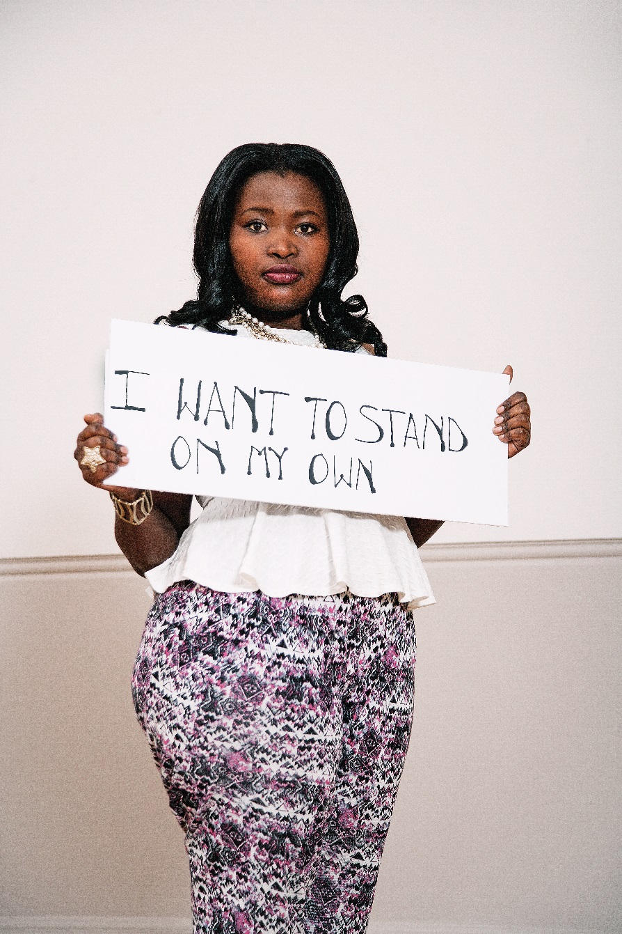
And to make a contribution to the
ECONOMIC
SOCIAL
and
CULTURAL
life
of
the
UK

Slide 33
OUR PROJECTS

Slide 34
Advice
Weekly immigration, housing and benefits advice drop-in (Tower Hamlets residents)
Monthly immigration advice drop in (pan-London)
Telephone advice (Wednesday 2 – 4.30pm)
Range of support groups and activities
Notes:
Legal Aid cuts have had a huge impact
Article 3 of the European Convention on Human Rights prohibits torture, and "inhuman or degrading treatment or punishment"

Slide 35
Street Legal
Linking immigration advisors with homeless outreach services
Immigration support key to breaking cycle and solving other needs
Over 900 non-EU migrants sleep rough in London every year

Slide 36
Praxis Homes
Social investment used to purchase homes
Homes leased to Praxis below market rate
Rooms let to local authorities
Social support and casework
Funding generated used for NRPF clients
Quicker resolution

Slide 37
Any questions?
www.praxis.org.uk
@Praxis_Projects
Praxis Community Projects

